Slide 1
Types of Tries

Slide 2
Types of Tries
A trie is a tree-like information retrieval data structure whose nodes store the letters of an alphabet. It is also known as a digital tree or a radix tree or prefix tree.
Tries are classified into three categories:
Standard Trie
Compressed Trie
Suffix Trie

Slide 3
Standard Trie
A Standard Trie has the below structure:
class Node
{
// Array to store the nodes of a tree
Node[] children = new Node[26];
// To check for end of string
boolean isWordEnd;
}
It is an ordered tree like data structure.
Each node(except the root node) in a standard trie is labeled with a character.
The children of a node are in alphabetical order.
Each node or branch represents a possible character of keys or words.
Each node or branch may have multiple branches.
The last node of every key or word is used to mark the end of word or node.

Slide 4
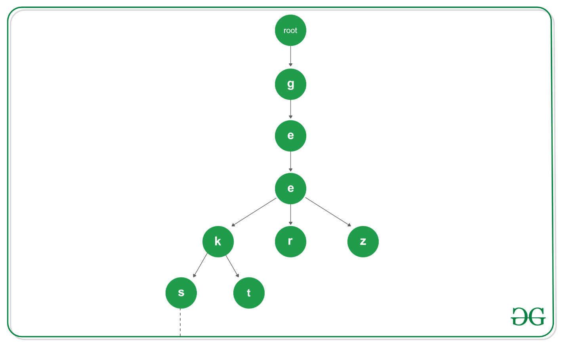
Illustration of the Standard Trie

Slide 5
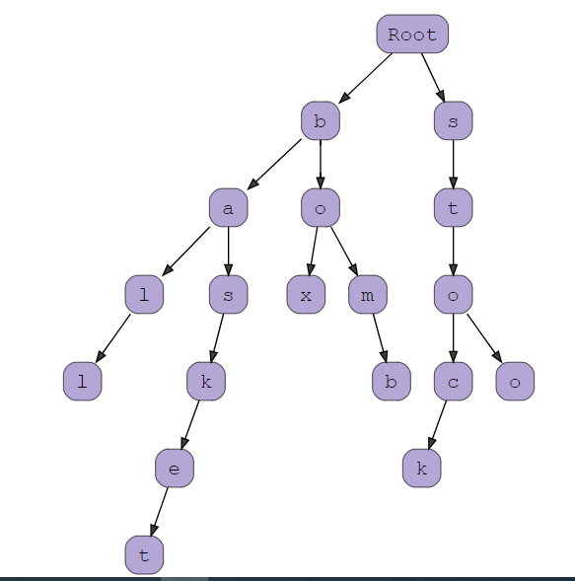
String S = {ball, box, bomb, basket, stock, stop} In standard trie, every traversal from the root node represents one of the words in the string S.

Slide 6
Compressed Trie
A Compressed Trie has the below structure:
class Node
{
// Array to store the nodes of tree
Node[] children = new Node[26];
// To store the edgeLabel
StringBuilder[] edgeLabel = new StringBuilder[26];
// To check for end of string
boolean isEnd;
}
A Compressed Trie is an advanced version of the standard trie.
Each nodes(except the leaf nodes) have atleast 2 children.
It is used to achieve space optimization.

Slide 7
Compressed Trie
To derive a Compressed Trie from a Standard Trie, compression of chains of redundant nodes is performed.
It consists of grouping, re-grouping and un-grouping of keys of characters.
While performing the insertion operation, it may be required to un-group the already grouped characters.
While performing the deletion operation, it may be required to re-group the already grouped characters.
A compressed trie T storing s strings(keys) has s external nodes and O(s) total number of nodes.

Slide 8
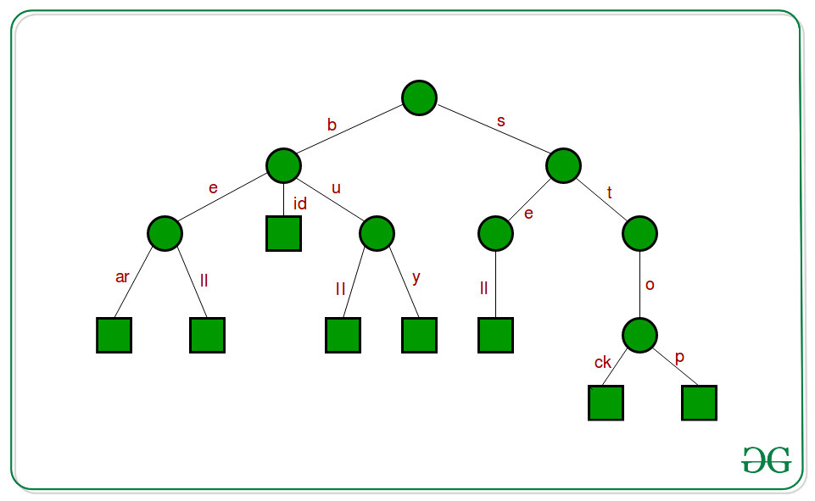
Illustration of the Compressed Trie

Slide 9
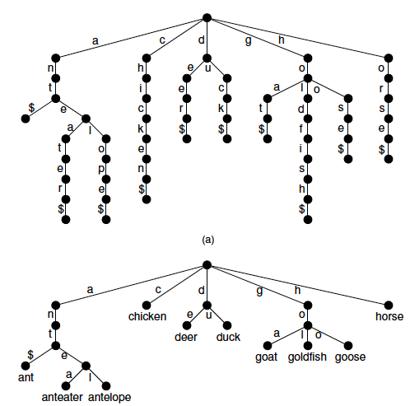
A compressed trie is space optimized: if a node is the only child of its parent, merge the node with the parent.

Slide 10
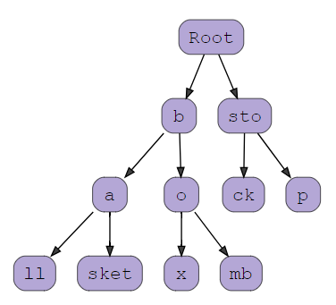
S[0] = b a l l
S[1] = b o x
S[2] = b o m b
S[3] = b a s k e t
S[4] = s t o c k
S[5] = s t o p

Slide 11
Suffix Trie
A Compressed Trie has the below structure:
struct SuffixTreeNode
{
// Array to store the nodes
struct SuffixTreeNode *children[256];
//pointer to other node via suffix link
struct SuffixTreeNode *suffixLink;
// (start, end) interval specifies the edge,
// by which the node is connected to its parent node
int start;
int *end;
// For leaf nodes, it stores the index of Suffix for the path from root to leaf
int suffixIndex;
}

Slide 12
Suffix Trie
A Suffix Trie is an advanced version of the compressed trie.
The most common application of suffix trie is Pattern Matching.
While performing the insertion operation, both the word and its suffixes are stored.
A suffix trie is also used in word matching and prefix matching.
To generate a suffix trie, all the suffixes of given string are considered as individual words.
Using the suffixes, compressed trie is built.

Slide 13
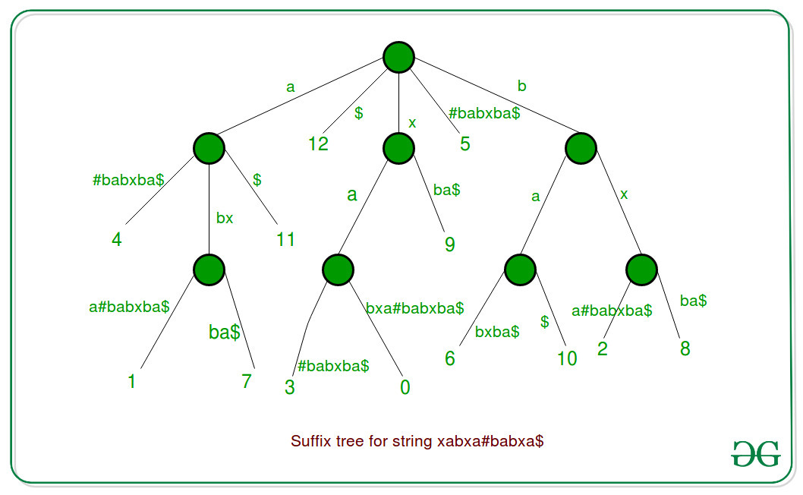
Illustration of the Suffix Trie

Slide 14
How to build a Suffix Tree for a given text?
Suffix Tree is compressed trie of all suffixes, so following are very abstract steps to build a suffix tree from given text.
1) Generate all suffixes of given text.
2) Consider all suffixes as individual words and build a compressed trie.
Let us consider an example text “banana\0” where ‘\0’ is string termination character. Following are all suffixes of “banana\0”

Slide 15
How to build a Suffix Tree for a given text?
Following are all suffixes of “banana\0”
banana\0
anana\0
nana\0
ana\0
na\0
a\0
\0

Slide 16
How to build a Suffix Tree for a given text?
If we consider all of the above suffixes as individual words and build a trie, we get following.

Slide 17
How to build a Suffix Tree for a given text?
If we join chains of single nodes, we get the following compressed trie, which is the Suffix Tree for given text “banana\0”

Slide 18
How to search a pattern in the built suffix tree?
Following are abstract steps to search a pattern in the built Suffix Tree.
Starting from the first character of the pattern and root of Suffix Tree, do following for every character.
For the current character of pattern, if there is an edge from the current node of suffix tree, follow the edge.
If there is no edge, print “pattern doesn’t exist in text” and return.
If all characters of pattern have been processed, i.e., there is a path from root for characters of the given pattern, then print “Pattern found”. Let us consider the example pattern as “nan” to see the searching process. Following diagram shows the path followed for searching “nan” or “nana”.

Slide 19
How to search a pattern in the built suffix tree?

Slide 20
Applications of Suffix Tree
Suffix tree can be used for a wide range of problems.
Following are some famous problems where Suffix Trees provide optimal time complexity solution.
1) Pattern Searching 2) Finding the longest repeated substring 3) Finding the longest common substring 4) Finding the longest palindrome in a string

